Slide 1
Data Reduction using t-SNE
t-Distributed Stochastic Neighbor Embedding

Slide 2
Contents
01
02
When and Why t-SNE is Used
Step 1: Data Standardization
03
04
Step 2: Pairwise Distance Matrix
Step 3: Conditional Probabilities
05
06
Step 4: Symmetric Joint Probabilities
Step 5: Low-Dimensional Initialization
07
08
What t-SNE Preserves (and What It Does Not)
Python Implementation

Slide 3
When and Why t-SNE is Used
Visualization Purpose
Reduces high-dimensional data to 2D or 3D for human interpretation and exploratory analysis.
Local Structure Focus
Preserves neighborhood relationships rather than global distances between observations.
Common Domains
Genomics, image features, text embeddings, single-cell RNA-seq, and general exploratory data analysis.

Slide 4
Athletics Data Snapshot
Country | 100m_s | 200m_s | 400m_s | 800m_min | 1500m_min | 5000m_min | 10000m_min | Marathon_min
Argentina | 10.39 | 20.81 | 46.84 | 1.81 | 3.7 | 14.04 | 29.36 | 137.72
Australia | 10.31 | 20.06 | 44.84 | 1.74 | 3.57 | 13.28 | 27.66 | 128.3
Austria | 10.44 | 20.81 | 46.82 | 1.79 | 3.6 | 13.26 | 27.72 | 135.9
Belgium | 10.34 | 20.68 | 45.04 | 1.73 | 3.6 | 13.22 | 27.45 | 129.95
Bermuda | 10.28 | 20.58 | 45.91 | 1.8 | 3.75 | 14.68 | 30.55 | 146.62
Brazil | 10.22 | 20.43 | 45.21 | 1.73 | 3.66 | 13.62 | 28.62 | 133.13
Burma | 10.64 | 21.52 | 48.3 | 1.8 | 3.85 | 14.45 | 30.28 | 139.95
Canada | 10.17 | 20.22 | 45.68 | 1.76 | 3.63 | 13.55 | 28.09 | 130.15
Chile | 10.34 | 20.8 | 46.2 | 1.79 | 3.71 | 13.61 | 29.3 | 134.03
China | 10.51 | 21.04 | 47.3 | 1.81 | 3.73 | 13.9 | 29.13 | 133.53
Colombia | 10.43 | 21.05 | 46.1 | 1.82 | 3.74 | 13.49 | 27.88 | 131.35

Slide 5
Problem Setup
Data Structure
Data matrix: n = 55 observations
Feature space: p = 8 variables
Target: 2-dimensional embedding
Core Objective
Map 8-dimensional data into 2-dimensional space while preserving the neighborhood structure that exists in the original high-dimensional space.
All pairwise distances are computed in the original 8-D space and remain fixed throughout.

Slide 6
Step 1: Data Standardization
Standardization Formula
Each variable is centered to mean zero and scaled to unit variance.
Critical Importance
Euclidean distance is highly sensitive to variable scale. Without standardization, high-variance variables dominate distance calculations, distorting neighborhood structure.

Slide 7
Step 2: Pairwise Distance Matrix
Compute Euclidean distances between all observation pairs in the standardized 8-dimensional space:
This produces a symmetric 55 × 55 distance matrix. These distances form the foundation of the algorithm and remain constant throughout optimization.
The distance matrix captures the geometric structure of the original high-dimensional data that t-SNE aims to preserve in lower dimensions.

Slide 8
Step 3: Conditional Probabilities
Distances are transformed into conditional probabilities that represent similarity relationships:
Nearby Points
Small distances yield probabilities close to 1
2. Distant Points
Large distances yield probabilities near 0
This Gaussian kernel transforms geometric distances into probabilistic similarities.

Slide 9
Role of Sigma (σᵢ)
The bandwidth parameter σᵢ controls the rate of probability decay with distance. Critically, each point has its own σᵢ, enabling local adaptivity to varying data densities.
Small σᵢ
Narrow Gaussian kernel
Very localized neighborhood
Only immediate neighbors have high probability
Large σᵢ
Wide Gaussian kernel
Broader neighborhood influence
More distant points retain significant probability

Slide 10
Perplexity: Effective Number of Neighbors
Perplexity quantifies the effective number of neighbors each point considers:
where the Shannon entropy is defined as:
Perplexity provides an intuitive, scale-free way to specify neighborhood size. A perplexity of 30 means each point effectively considers about 30 neighbors, regardless of dataset density.

Slide 11
How σᵢ is Determined
For each point i, σᵢ is chosen so that the entropy of its probability distribution matches the target:
Initialize σᵢ
Start with an initial bandwidth estimate
2. Compute probabilities
Calculate p_{(j|i)} for all j using current σᵢ
3. Measure entropy
Evaluate H(Pᵢ) for the current distribution
4. Adjust via binary search
Increase or decrease σᵢ based on entropy gap
5. Iterate to convergence
Repeat until target entropy is achieved
4. Adjust via binary search
Increase or decrease σᵢ based on entropy gap

Slide 12
Binary Search for σᵢ
The search for σᵢ exploits a fundamental monotonicity property: entropy increases strictly with σᵢ.
Entropy Too Low
Distribution is too concentrated
→ Increase σᵢ
Entropy Too High
Distribution is too spread out
→ Decrease σᵢ
Binary search guarantees logarithmic convergence, ensuring efficient computation even for large datasets. This adaptive procedure ensures each point achieves its target perplexity regardless of local density.

Slide 13
Step 4: Symmetric Joint Probabilities
Conditional probabilities p_{(j|i)} are asymmetric. To create a symmetric similarity matrix, we average forward and reverse conditional probabilities:
Division by 2n ensures probabilities sum to 1 across all pairs. This matrix P represents the final high-dimensional similarity structure that t-SNE seeks to preserve in the low-dimensional embedding.

Slide 14
Step 5: Low-Dimensional Initialization
Initialize the 2-dimensional coordinates for each observation:
Random Initialization
Sample coordinates from a small Gaussian distribution centered at the origin.
Simpler but may require more iterations
PCA Initialization
Use the first two principal components as starting coordinates.
More stable convergence and reproducible results

Slide 15
Low-Dimensional Similarities
In the 2-dimensional embedding space, similarities are defined using a Student-t distribution with one degree of freedom:
Why Student-t?
Heavy tails prevent the "crowding problem" where moderate distances in high dimensions cannot be faithfully represented in low dimensions.
Geometric Implication
Distant points in 2D can remain far apart without incurring large penalties, while nearby points are tightly constrained.

Slide 16
Objective Function: KL Divergence
t-SNE minimizes the Kullback-Leibler divergence between the high-dimensional probability distribution P and the low-dimensional distribution Q:
The asymmetric KL divergence imposes a strong penalty when points that are neighbors in high-dimensional space (large pᵢⱼ) are placed far apart in low-dimensional space (small qᵢⱼ). This asymmetry is crucial for preserving local structure.

Slide 17
Point Pulling: Core Intuition
Each pair of points exerts attractive or repulsive forces based on the mismatch between high-dimensional and low-dimensional probabilities:
Attraction: p_{ij} > q_{ij}
Points are too far apart in 2D relative to their high-dimensional similarity. They are pulled together to increase qᵢⱼ.
Repulsion: q_{ij} > p_{ij}
Points are too close together in 2D relative to their dissimilarity. They are pushed apart to decrease qᵢⱼ.
The magnitude of these forces is proportional to the probability mismatch, creating a complex system of interactions that shapes the final embedding.

Slide 18
How σᵢ Affects Point Pulling
The choice of σᵢ (controlled by perplexity) fundamentally determines which point pairs exert significant forces:
Small σᵢ Effect
Few point pairs have large pᵢⱼ
Strong, focused attractive forces
Tight, well-separated local clusters
More sensitive to local density variations
Large σᵢ Effect
Many point pairs have moderate pᵢⱼ
Diffuse, distributed forces
Smoother global structure
Less emphasis on fine-scale patterns

Slide 19
Gradient Descent Optimization
Coordinates are updated iteratively using gradient descent to minimize KL divergence. The gradient with respect to yᵢ incorporates both attractive and repulsive forces from all other points.
1. Early Exaggeration
Initial iterations multiply pᵢⱼ by 4–12 to amplify attractive forces and form clear cluster separation.
2. Standard Optimization
After ~250 iterations, return to original pᵢⱼ values for fine-tuning of local structure.
3. Momentum
Gradient updates include momentum terms to accelerate convergence and escape poor local minima.

Slide 20
What t-SNE Preserves (and What It Does Not)
Preserved
Local neighborhood structure
Relative proximities within clusters
Manifold topology
Not Preserved
Global distances between clusters
Cluster sizes and densities
Axis scales and directions
Outlier distances
t-SNE is fundamentally a local method. Inter-cluster distances in the embedding are not meaningful and should not be interpreted.

Slide 21
Practical Guidance (n = 55, p = 8)
Perplexity Selection
For n = 55, recommended range is 5–15. Lower values emphasize very local structure; higher values incorporate more global context.
Multiple Random Seeds
t-SNE is non-convex and sensitive to initialization. Run multiple seeds and examine consistency of patterns.
Always Standardize
Variable scaling directly affects distance calculations. Standardization is not optional.
Labels for Interpretation Only
Class labels can help interpret clusters but should never be used to validate the embedding quality or make statistical inferences.

Slide 22
Python Implementation
Implementing t-SNE in Python using scikit-learn is straightforward. Here's a complete example for our n=55, p=8 dataset:
from sklearn.manifold import TSNE
from sklearn.preprocessing import StandardScaler
import numpy as np
import matplotlib.pyplot as plt
# Step 1: Standardize the data
scaler = StandardScaler()
X_standardized = scaler.fit_transform(X)
# Step 2: Initialize and fit t-SNE
tsne = TSNE(
n_components=2,
perplexity=30,
learning_rate=200,
random_state=42
)
athletics_tsne = tsne.fit_transform(athletics_scaled)

Slide 23
Python Implementation (continued)
# Step 3: Visualize the results
import matplotlib.pyplot as plt
plt.figure(figsize=(10, 7))
plt.scatter(tsne_df['TSNE_1'], tsne_df['TSNE_2'])
for i in range(len(tsne_df)):
plt.text(
tsne_df.loc[i, 'TSNE_1'],
tsne_df.loc[i, 'TSNE_2'],
tsne_df.loc[i, 'Country'],
fontsize=8,
alpha=0.8
)
plt.xlabel('t-SNE Component 1')
plt.ylabel('t-SNE Component 2')
plt.title('t-SNE Visualization of Athletics Performance Data (Country-wise)')
plt.show()

Slide 24
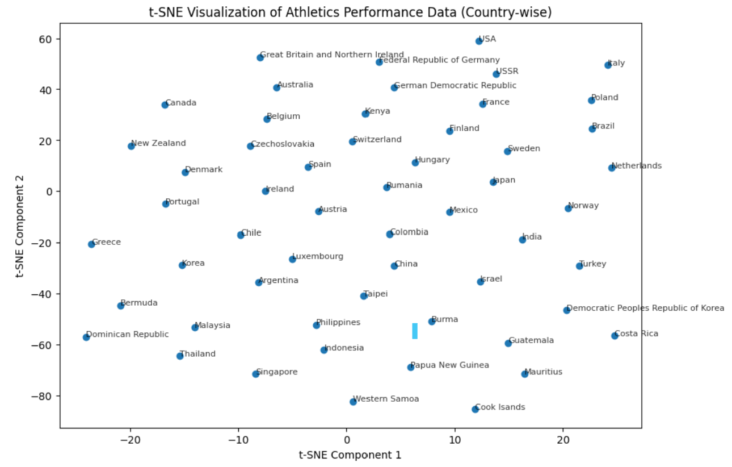
Python Visualization

Slide 25
Practical Guidance and Key Takeaways
Perplexity Selection
For n = 55, recommended range is 5–15. Lower values emphasize very local structure; higher values incorporate more global context.
Multiple Random Seeds
t-SNE is non-convex and sensitive to initialization. Run multiple seeds and examine consistency of patterns across runs.
Always Standardize
Variable scaling directly affects distance calculations. Standardization is not optional—it's a critical preprocessing step.
Labels for Interpretation Only
Class labels can help interpret clusters but should never be used to validate the embedding quality or make statistical inferences.
Remember: t-SNE reveals local structure brilliantly but cannot be used for measuring global distances, making predictions, or statistical testing. It's an exploratory visualization tool, not an inference method.

